Slide 1

Collaboration | Innovation | Excellence
Presentation On Testing
October 2019

Slide 2

Agenda
Introduction to Testing.
Types of Testing.
Automation Vs Manual Features.
Testing Life Cycle Model in Software Development.
Requirement Gathering
Test Planning
Test Case Development
Test Case Execution
Automation Tools & Technologies
Mobile Testing
Mobile Application testing using Appium.
Wireless mobile testing using selenium grid.
Performance Testing
Security Testing

Slide 3
Introduction to Testing
Software testing is a process of evaluating a system by manual or automatic and verify that it satisfies the actual requirement.
Software testing is the process of executing a software system to determine whether it matches its specification and executes in its intended environment.
Software testing is nothing but an art of investigating software to ensure that its quality under test is in line with the requirement of the client. Software testing is carried out in a systematic manner with the intent of finding defects in a system. It is required for evaluating the system.

Slide 4
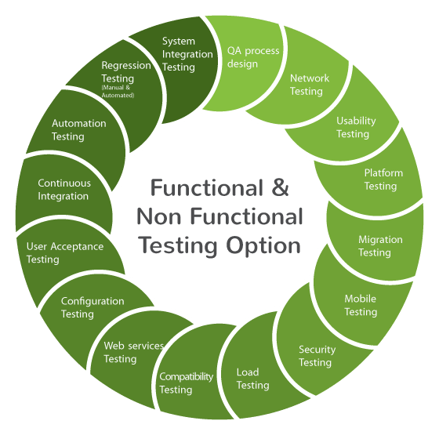
Types Of Testing
TESTING TYPES
FUNCTIONAL
PENETRATION
DATABASE
MOBILE TESTING
WEBSERVICES
PERFORMANCE

Slide 5




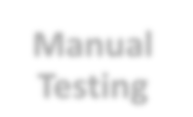
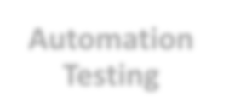
Manual Vs Automation
Manual
Automation
Testing
Testing
1. Time consuming and tedious: Since test cases are executed by human resources so it is very slow and tedious.
1. Fast: Automation runs test cases
significantly faster than human resources.
2. Huge investment in human resources: As test cases need to be executed manually so more testers are required in manual testing.
2. Less investment in human resources: Test cases are executed by using automation tool so less tester are required in automation testing.
3. Less reliable: Manual testing is less reliable as tests may not be performed with precision each time because of human errors.
3. More reliable: Automation tests perform precisely same operation each time they are run.
4. Non-programmable: No programming can be done to write sophisticated tests which fetch hidden information.
4. Programmable: Testers can program sophisticated tests to bring out hidden information.

Slide 6
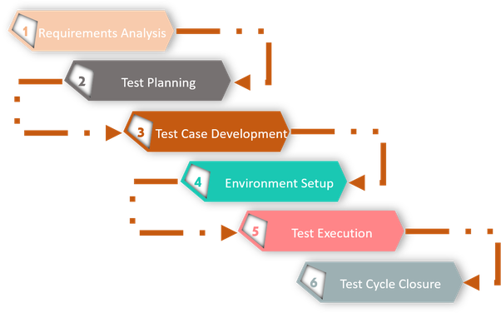
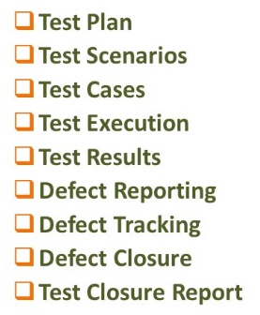
Testing Life Cycle Model

Slide 7
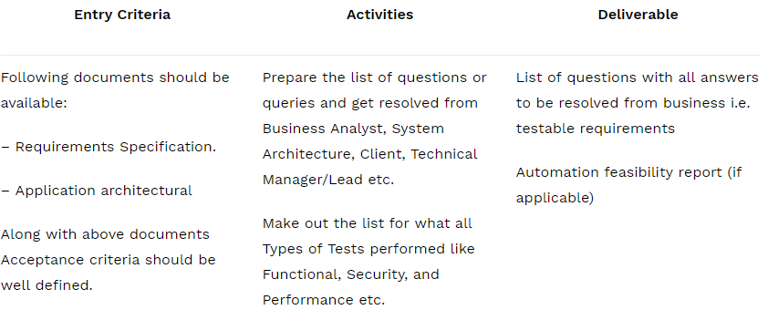
Requirement Analysis
In this step QA team understands the requirement in terms of what we will testing & figure out the testable requirements. If any conflict, missing or not understood any requirement, then QA team follow up with the various stakeholders like BA, System Architecture, Client, Technical Manager/Lead etc to better understand the detail knowledge of requirement.

Slide 8
Test Planning
In this phase typically Test Manager (or) Test Lead involved to determine the effort and cost estimates for entire project and will preparing the Test Plan.
Test Plan Document
Define Objective & scope of the project.
List down the testing types involved in the STLC.
Test effort estimation and resource planning.
Selection of testing tool if required.
Define the testing process overview.
Define the test environment required for entire project.
Prepare the test schedules.
Define the control procedures.
Determining roles and responsibilities.
List down the testing deliverable.
Define the entry criteria, suspension criteria, resumption criteria and exit criteria.
Define the risk involved if any.
Test Effort Estimation Document
Work Breakdown Structure (WBS)
Three Point Estimation
Functional Point Method

Slide 9

Test Case Development
Where testing team write down the detailed test cases along with the test data based on the userstories. Once the test cases are ready then these test cases are reviewed by peer members or QA lead.
Also the Requirement Traceability Matrix (RTM) is prepared.
Preparation of Test Scenarios(Optional)
Preparation of Test Cases.
Preparation of Test Automation Scripts (if required)..

Slide 10





Test Execution
Testing team start executing test cases based on prepared test planning & prepared test cases in the prior step.
Based on test planning execute the test cases.
Mark status of test cases like Passed, Failed, Blocked, Not Run etc.
Assign Bug Id for all Failed and Blocked test cases.
Do Retesting once the defects are fixed.
Track the defects to closure.

Slide 11



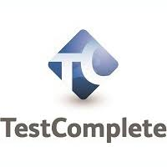










Automation Tools and Technologies
Automation
Project Sourcing
Functional and performance test automation across varied tool stacks
CI/CD integration
Version controlling
Integration with test management tools and custom reports
Project wise framework development
Staff and manage QA teams to deliver against defined scope
Ensuring cost arbitrage by creating smaller dedicated teams with flexibility to scale team size on demand
Technical Capability
Selenium Webdriver
TestNG
Test Complete
Appium
Jmeter
Maven/Ant
Jenkin
GIT/GIT Hub
Frame Work Design(Data Driven, POM, Hybrid)
Behaviour Driven Development(Cucumber)

Slide 12










Mobile Testing
Native
Upgrades
Function al
Key Focus Areas
Device Proliferati on
Security
Performanc e & Usability
Mobile Web
Stability
Hybrid

Slide 13
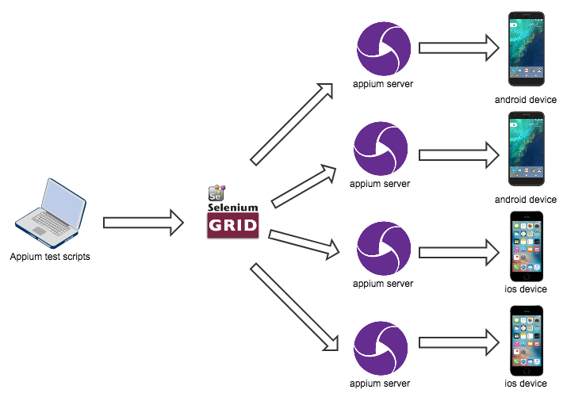

Wireless Mobile Testing using GRID
Selenium Grid is a part of the Selenium Suite that specializes in running multiple tests across different mobiles, browsers, operating systems, and machines in parallel.

Slide 14



Web Services Testing
Web Service Testing is to verify that all of the Application Programming Interfaces (APIs) exposed by your application operate as expected.
SOAP (Simple Object Access Protocol)
REST (Representational State Transfer architecture)

Slide 15


Performance Testing
PERFORMANCE TESTING is a type of software testing that intends to determine how a system performs in terms of responsiveness and stability under a certain load.
Load Testing
Stress Testing
Endurance Testing
Spike Testing
Volume Testing
Scalability Testing
Response Time
Throughput
Resource Utilization
outer limits of the application
re-run with incremental application breaks down

Slide 16


Security Testing
OWASP TOP 10 Vulnerabilities
Injection
Broken Authentication
Sensitive data exposure
XML External Entities (XXE)
Broken Access control
Security misconfigurations
Cross-Site Scripting (XSS)
Insecure Deserialization
Using Components with known vulnerabilities
Insufficient logging and monitoring
And more…

Slide 17


Testing Experience @Oakton
Application Manual Testing
Identified gaps in requirements and had discussions with BA regarding those gaps
Designing and maintaining test cases for the project.
Involved in Functional and regression testing of the project.
Preparing Test estimate based on number of resources available.
Assigning tasks to the peers and coordinating the testing efforts.
Preparing Test Metrics
Designed test cases and Performed the Peer reviews and reviews
Identifying regression suite from existing test cases and modified test cases based on current requirements.
Mapping test cases to RTM and validating the completeness of coverage of requirements
Verified Web Services like SOAP, REST.
Tested Web Services using tools like SOAPUI, POSTMAN.
Participated in test execution cycle that includes functional, Regression, security, Cross browsing testing
Tested critical bug fixes and coordinated with the developers in release of bug fixes meeting tight time line.
Executing the test cases and logging defects in defect tracking tool.

Slide 18
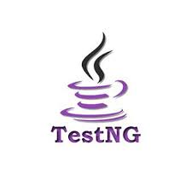
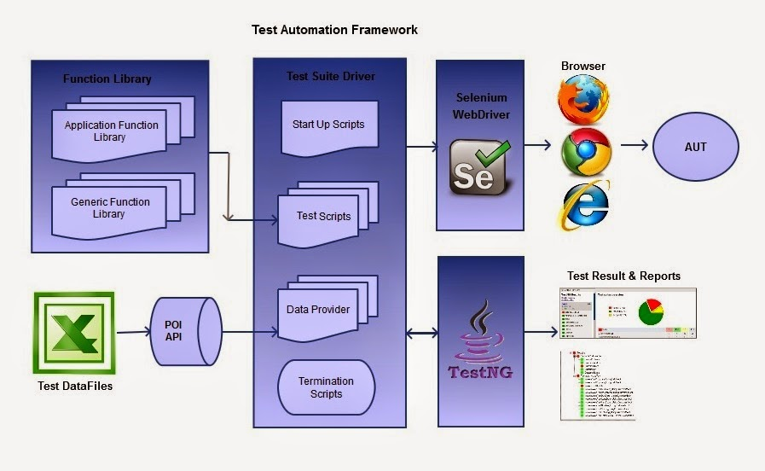
Testing Experience @Oakton
Application Automation Testing
Identify the test cases needs to automate.
Develop the scripts by using TestNG with Web driver and used Hybrid framework.
Test scripts generation, customization to multiuser scripts.
Execution of the scripts on different environments.
Integrate the scripts with framework
Stabilize all the developed scripts

Slide 19

Expertise You Can Trust…..

